Slide 1
Mental disorders
Final project – mariana macdonald
Dsc 530 – Bellevue university

Slide 2
Hypothetical question
In this project, I wanted to know which mental disorder is more frequent, depression or others and how is depression compared to age, marriage, work. Specifically looking at these variables: gender, age, the person’s marital status, work status.

Slide 3
Variables used for this project analysis
gender : 1 for female or 2 for male
age : in age groups
afftype: 1: bipolar II, 2: unipolar depressive, 3: bipolar I
edu : education grouped in years
work : 1: working or studying, 2: unemployed/sick leave/pension

Slide 4
Outcome of your eda
I wanted to know how the age affected the people with depression and people with other disorders so I divided the data into 2 groups, one for depression and the other for all the other disorders.
Doing a CDF calculation, I found out that the probability of having depression at ages 35-39 are higher than when younger, at a 42% probability. Also, the comparison of PMF for depression and other disorders show the age bracket with higher frequency for all the disorders is between 50-54.

Slide 5
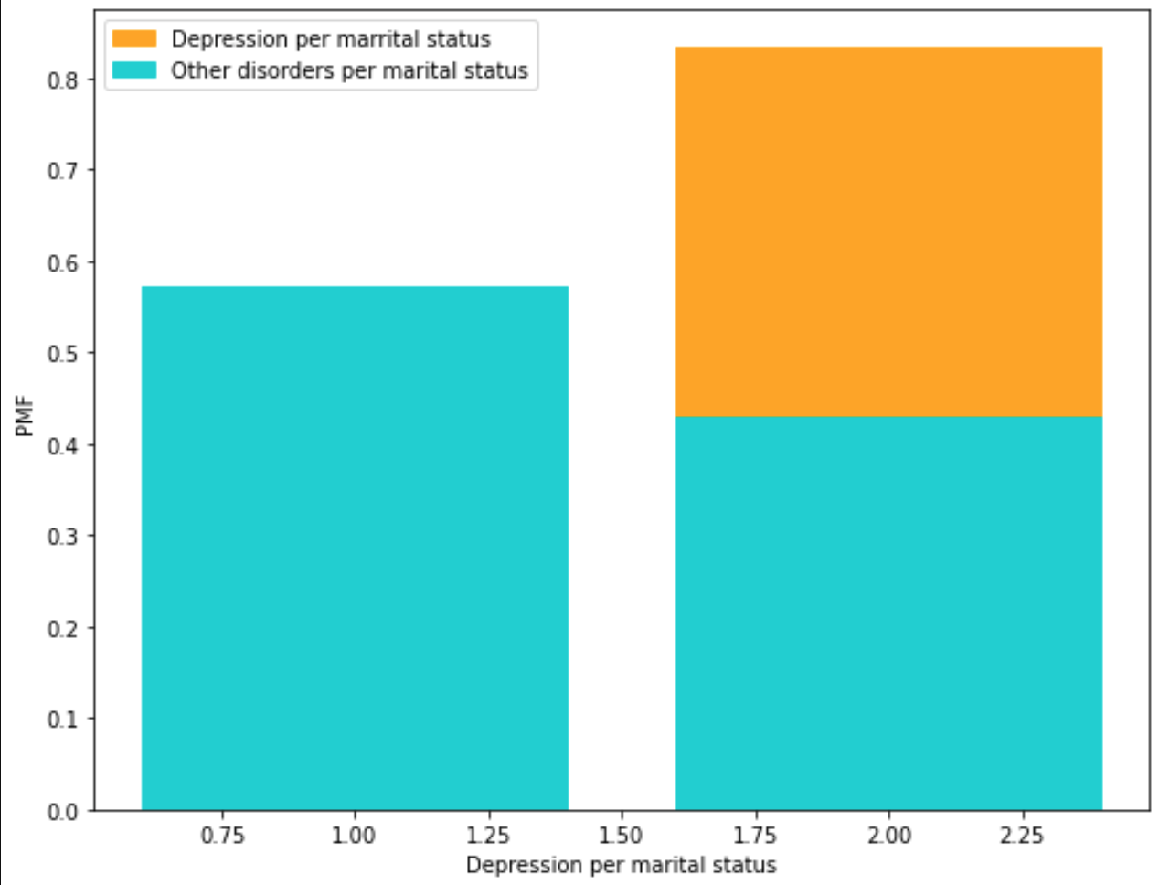
Mean depression per marital
status: 1.8333333333333335
Mean disorders per marital
status 1.4285714285714284

Slide 6
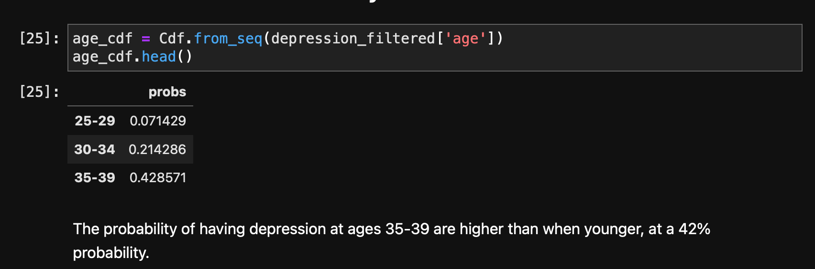
CFD – probability of having depression x age

Slide 7
references
https://www.kaggle.com/datasets/arashnic/the-depression-dataset
https://www.kaggle.com/code/docxian/depression-and-motor-activity/notebook

